Slide 1

MarketMinds : Unleashing Marketminds Insights Through LLM
Priyanshu worlikar- 22207001
Harshad raurale – 22207002
Saaras gaikwad -22207003
Umesh nehete- 22207006
Project Guide
Ms. Sarala Mary

Slide 2
Outline
Introduction
Literature Survey of the existing systems
Limitations of the existing systems
Problem statement
System Design
Technologies and methodologies
Implementation
Conclusion
References

Slide 3
Introduction
In today's digital world, building a strong brand presence and engaging with customers is essential for the success of any business.
For managing various aspects of online branding, from social media presence to customer interactions, can be challenging and time-consuming.
To address these challenges, we introduce the Brand Builder project. Brand Builder is a comprehensive platform designed to simplify the process of brand management and customer engagement.
Whether you're a small startup or a large corporation, Brand Builder offers tools and features to help you create, manage, and grow your brand effectively.

Slide 4
Motivation :
Industry Trends: The evolving landscape of digital marketing and social media has heightened the importance of authentic storytelling. With consumers being bombarded by advertisements daily, brands need to cut through the noise and resonate with their target audience on a deeper level.
Market Demand: Many marketers struggle to effectively convey their brand's message while staying informed about competitors' strategies.
Objectives:
Increase Competitive Advantage: Enable brands to stay ahead of the competition by leveraging insights derived from comprehensive competitor analysis and strategic storytelling.
Drive Business Growth: Ultimately, contribute to the success and growth of brands by providing them with the tools and resources they need to excel in today's competitive marketplace

Slide 5
Literature Survey of the existing system
Author | Year | Title | Methods used | Merits | Demerits
Bulut, A., & Mahmoud | 2023 | Generating Campaign Ads & Keywords for Programmatic Advertising | GeNN, | -Campaign data and Google's keyword planner forecasts | -Uses GPT-2 models which has low accuracy and not contains all niche domains.
Vaswani, A., Jones, L., Gomez, A. N., & Kaiser, Ł. | 2016 | "Attention is All You Need." | Self-Attention Mechanism | - RNN and Short term memory networks | -Dependence on quality and relevance of input data.
Ozkaya, I. | 2023 | "Application of Large Language Models to Software Engineering Tasks: Opportunities, Risks, and Implications." | Llama-1 model | Enhanced prompt generation and transparency in contracts. | Complexity and scalability issues in generating prompts

Slide 6
Limitations of existing systems
From this paper[1] : The limitations of the GeNN platform include the reliance on GPT-2 models, which may not cover all niche domains effectively.
From this paper [2]: limitations of existing sequence-to-sequence models, such as recurrent neural networks (RNNs) and long short-term memory networks (LSTMs), in handling long-range dependencies and parallelizing computation effectively.
Complexity of existing tool: Some competitor analysis tools may be overly complex or technical, requiring specialized knowledge or training to use effectively

Slide 7
Problem statement
Existing brand storytelling platforms lack integration with competitor analysis tools, which restricts workflows and limits insights. Prompt generation has some limitations, such as dependency on the GPT-2 Model, while competitor analysis requires real-time data.

Slide 8
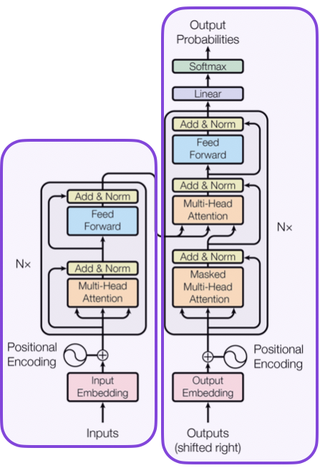
System Design
BrandBuilder
Analytic
Dashboard
Transformer
Model
Data collection : Instagram And Linkedn API
Data preprocessing : Null and inaccurate data removing
Data Modelling in ANN
Data Visualization : bar graphs and charts

Slide 9
Technologies and methodologies
LLama-2
Tailwind CSS
PYTHON 3
DJANGO
POSTGRES

Slide 10
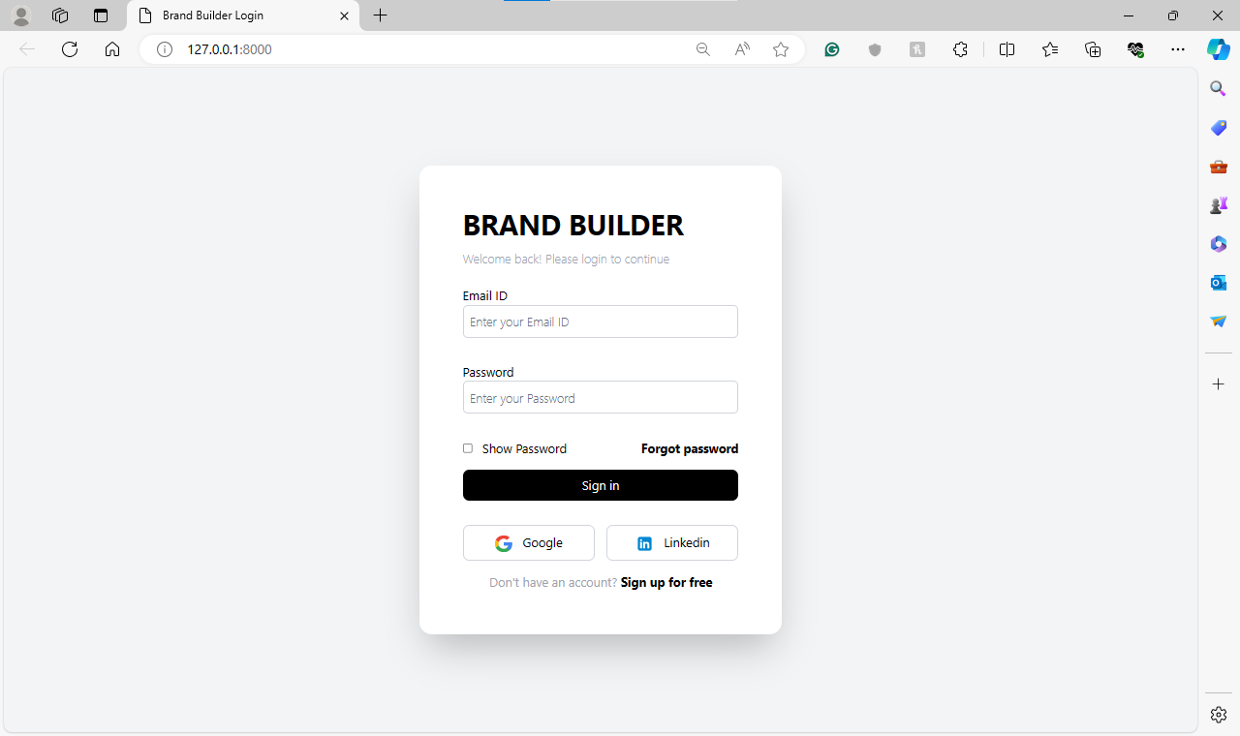
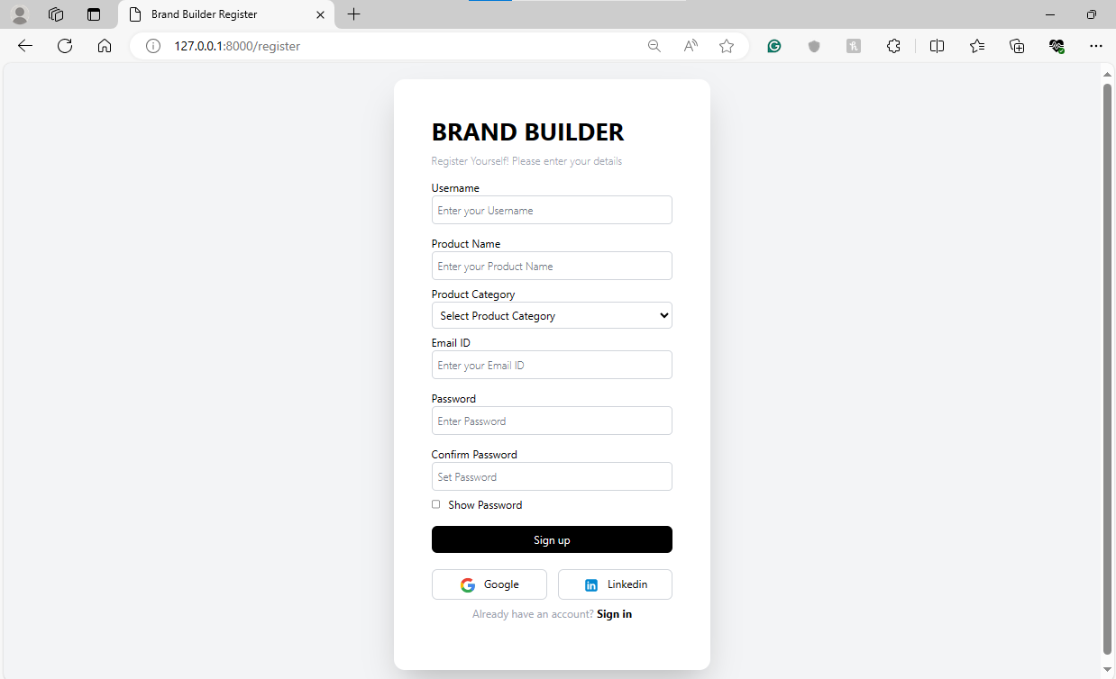
Implementation

Slide 11
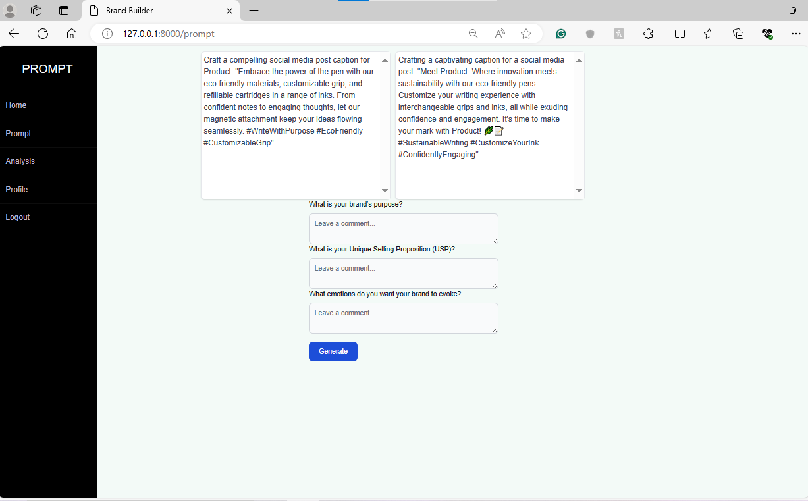
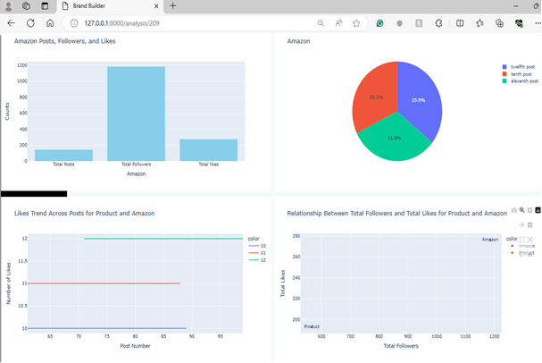
Implementation

Slide 12
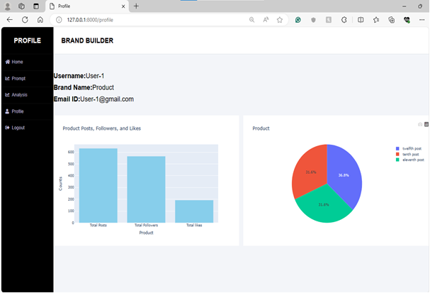
Implementation

Slide 13
Conclusion
Our project provides a unified platform integrating essential technologies and APIs, enabling businesses to streamline workflows and centralize data management efficiently.
Prioritizing user experience, scalability, and competitive advantage, our platform empowers businesses to optimize their online presence and drive meaningful engagement with their audience.

Slide 14
References
Bulut, A., & Mahmoud, A. (24 April 2023). "Generating Campaign Ads & Keywords for Programmatic Advertising."
Vaswani, A., Jones, L., Gomez, A. N., & Kaiser, Ł. (2016). "Attention is All You Need."
Ozkaya, I. (26 April 2023). "Application of Large Language Models to Software Engineering Tasks: Opportunities, Risks, and Implications."

Slide 15
Thank You...!!

